Slide 1

Banaras Hindu University ( rajiv Gandhi South Campus)
Heart Disease Prediction With Machine Learning:
:- Using Logistic Regression
Under the Guidance of:-
Prof. Manoj Mishra
Department of Computer Science, (BHU)
Presented by:-
Atul Gupta
MCA [3rd Sem] 20430MCA001

Slide 2
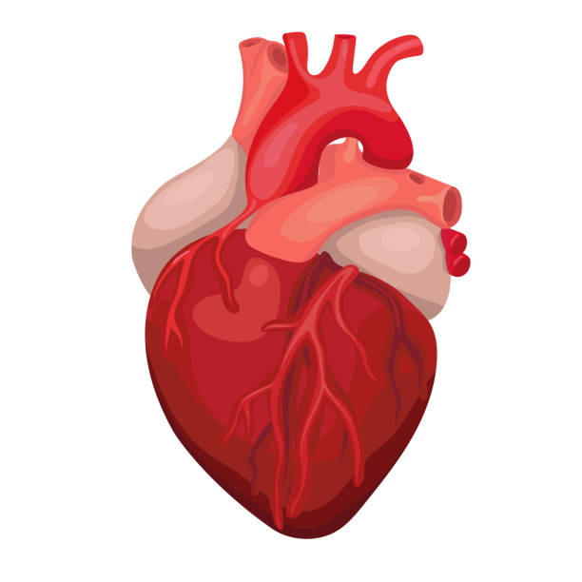
Heart disease prediction -With Python Machine learning project

Slide 3
Introduction
Cardiovascular disease (CVD) is a general term for a disease of heart or blood vessels. Blood flow to heart ,brain or body is reduced because of:
A blood cot
A build-up of fatty deposits inside an artery , leading to hardening and narrowing of artery
Type of CVD:
Coronary heart disease
Stroke
Peripheral arterial disease

Slide 4
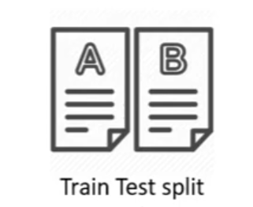

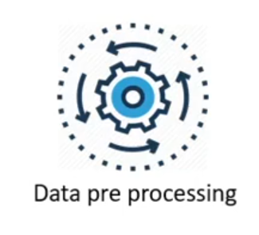
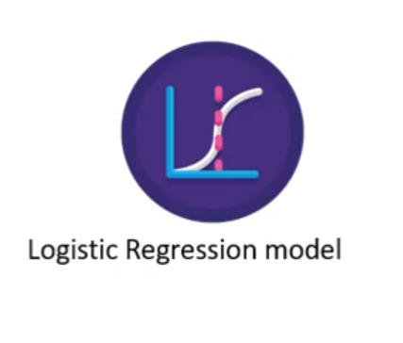
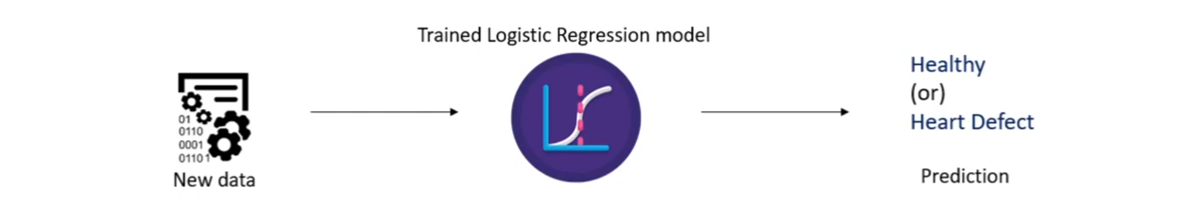
Work flow

Slide 5
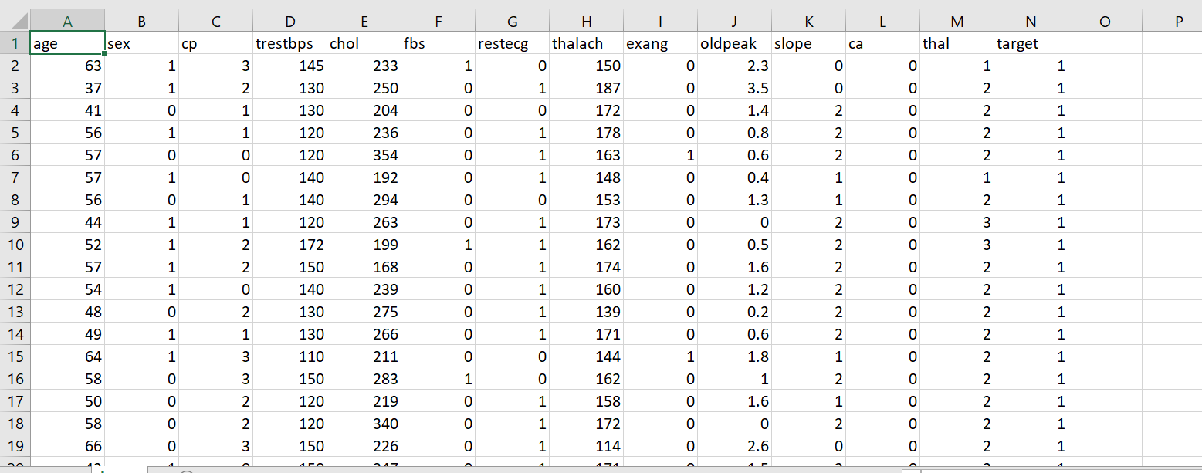
Description about Dataset
There are total of 13 features and 1 target variable.
If Target value ‘1’ :→ Defective Heart
Target value ‘0’ :→ Healthy Heart

Slide 6
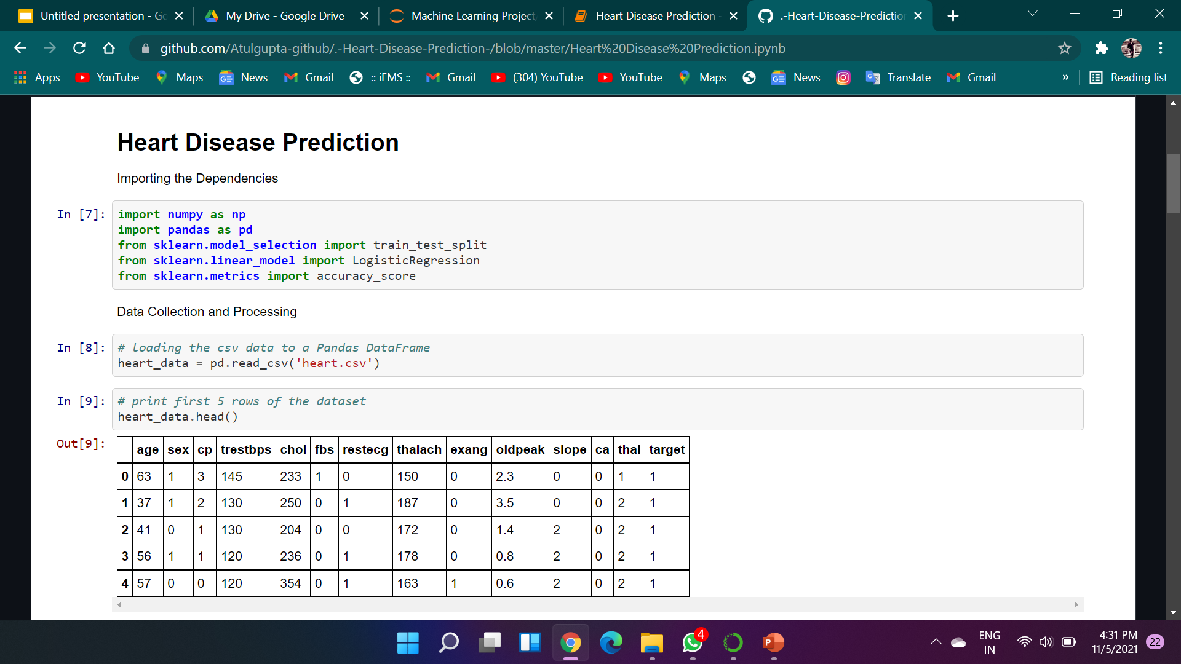

Slide 7
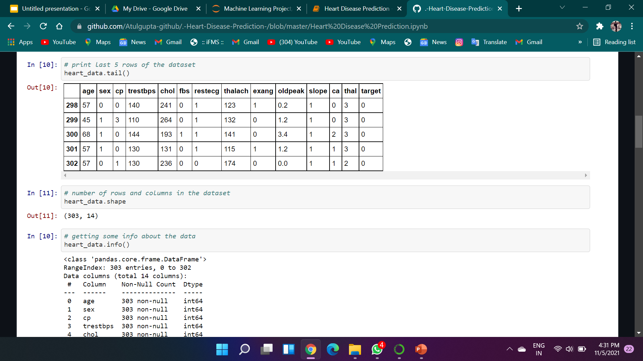

Slide 8
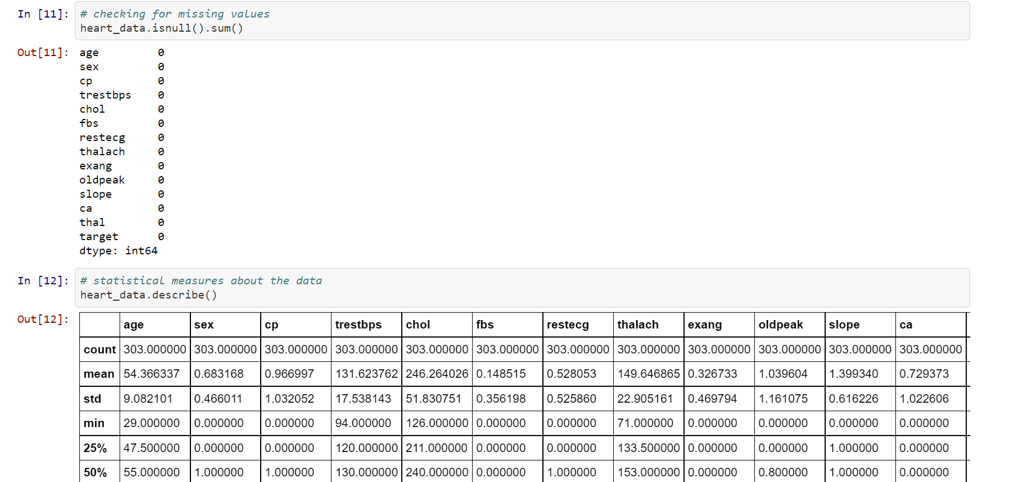

Slide 9
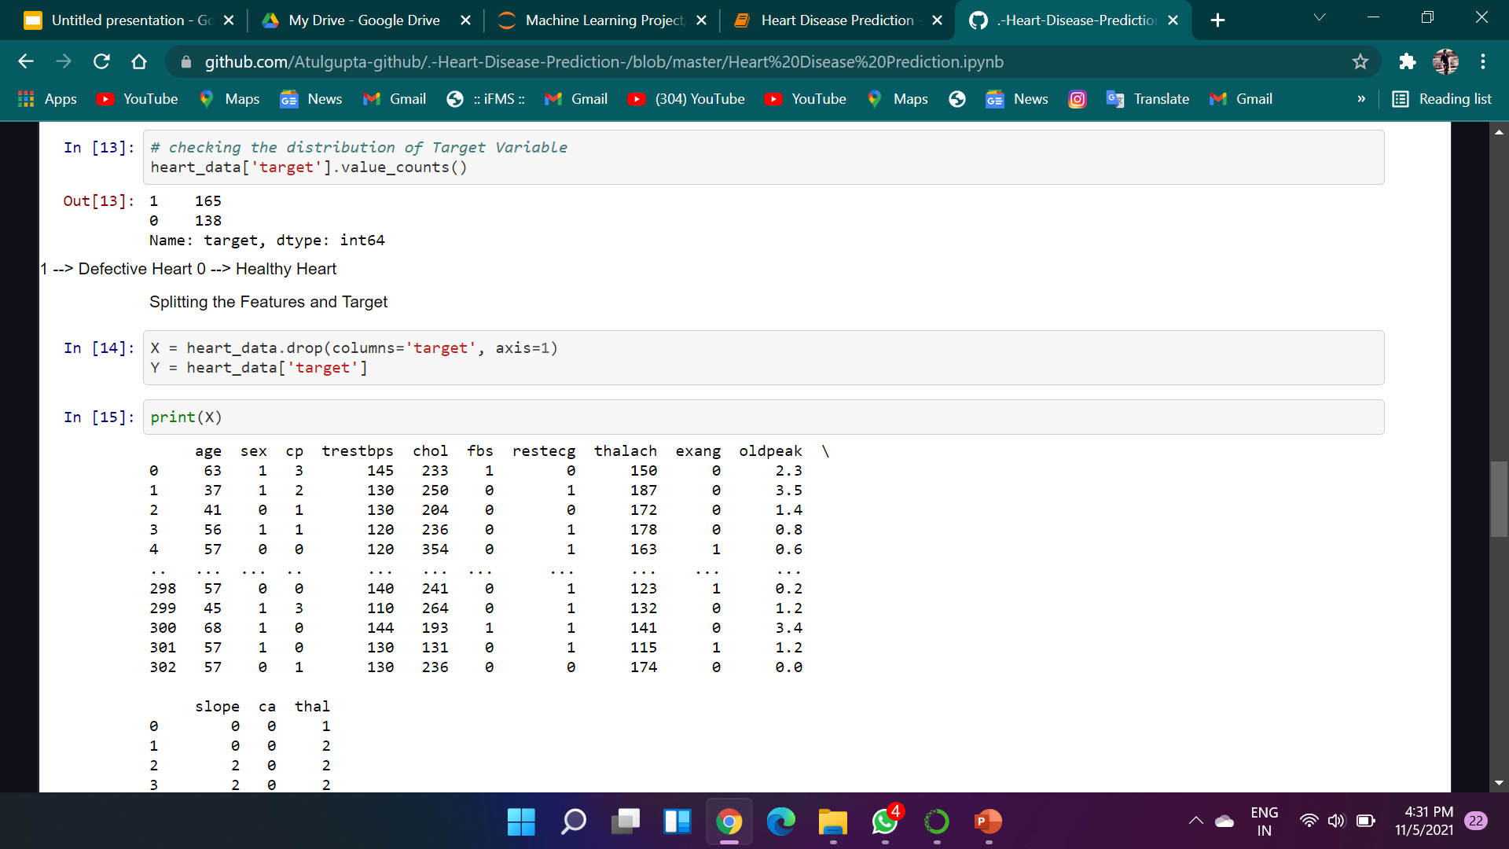

Slide 10
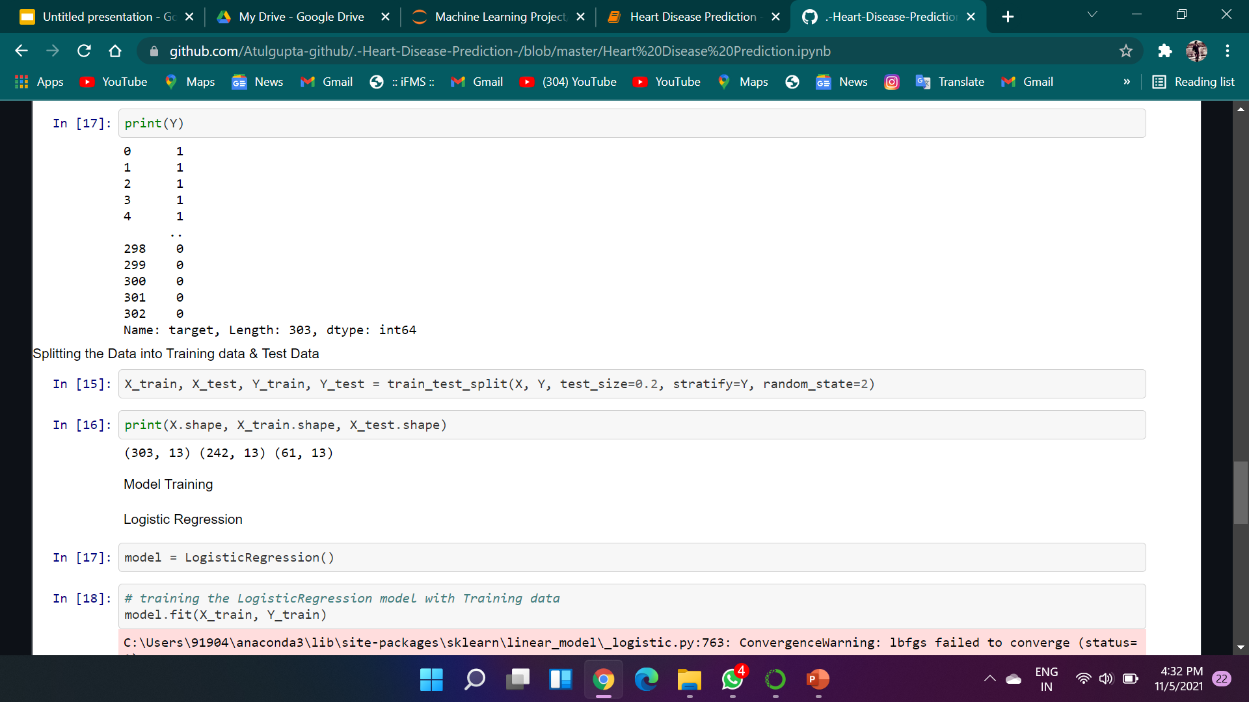

Slide 11
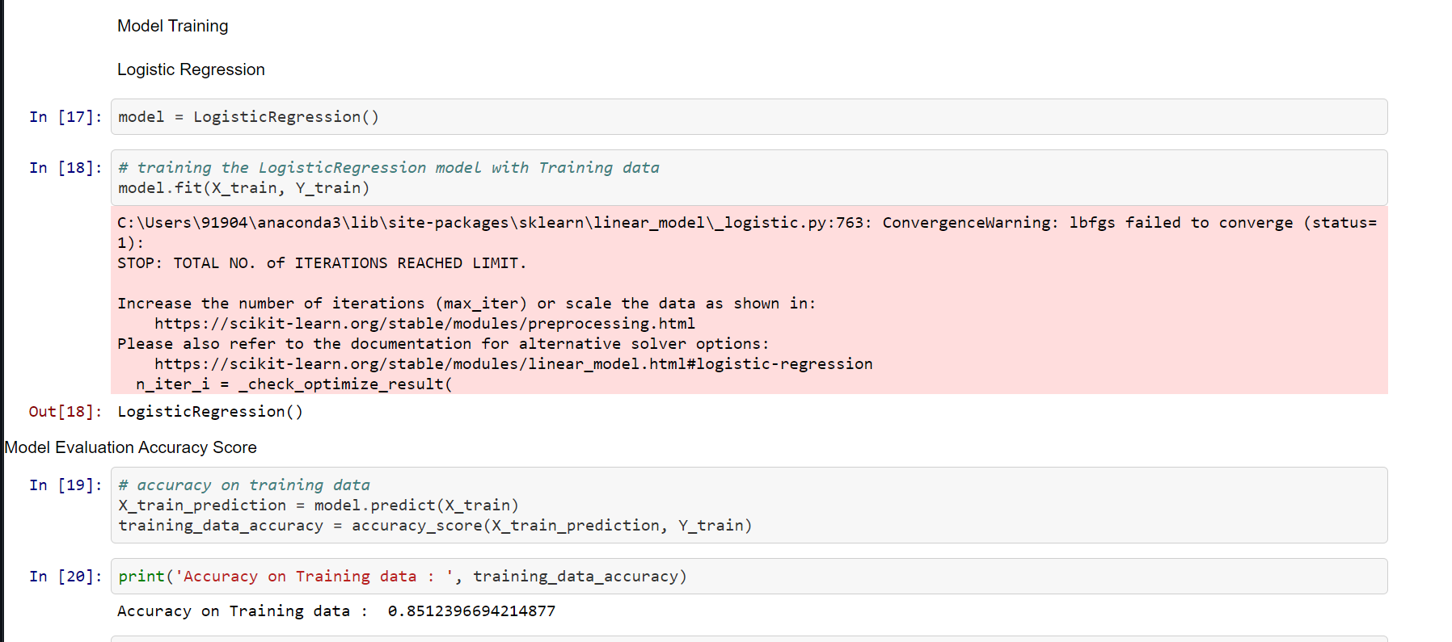

Slide 12
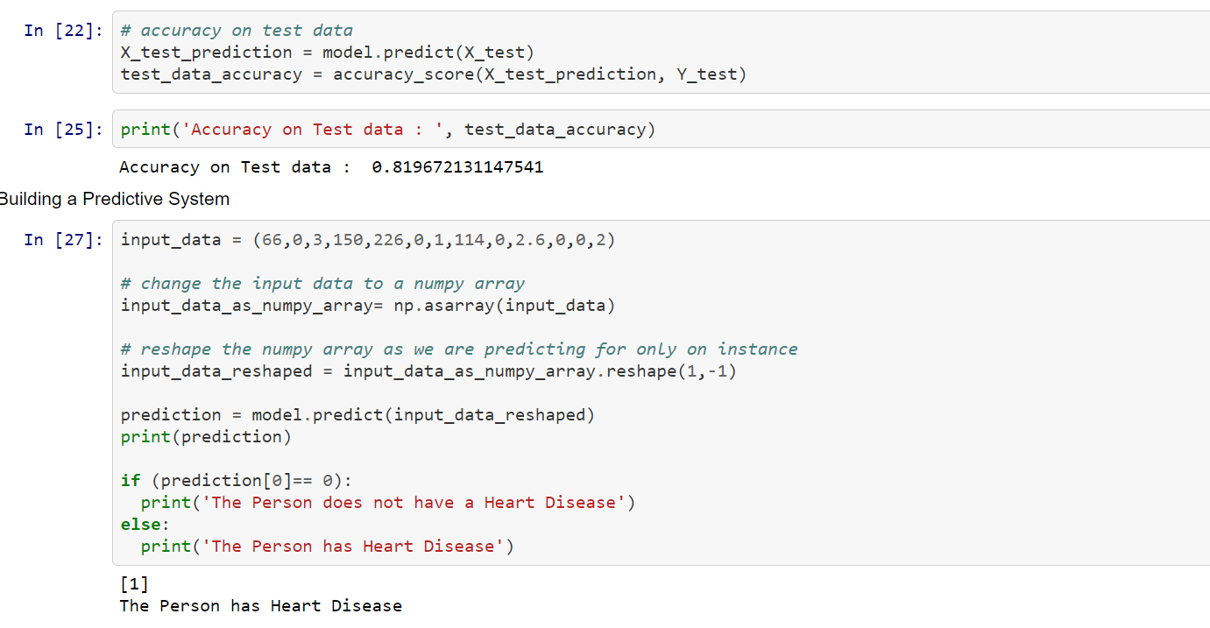

Slide 13
Algorithm CAN BE used :→
Logistic Regression
Naïve Bayes Classifier
K Neighbors Classifier
Decision Tree Classifier
Support Vector Classifier
Random Forest Classifier

Slide 14
Conclusion :>
Heart Disease is one of the major concerns for society today.
It is difficult to manually determine the odds of getting heart disease based on risk factors. However , Machine learning techniques are useful to predict the output form existing data.
Machine Learning is an effective way to deal with these problems. It is widely used in many areas.

Slide 15
THANK YOU..

